Slide 1


Slide 2

Data Visualization

Slide 3



Data Visualization
is the representation of data or information in a graph, chart, or other visual format.
It communicates relationships of the data with images.
Notes:
Data visualization is the representation of data or information in a graph, chart, or other visual format. It communicates relationships of the data with images. This is important because it allows trends and patterns to be more easily seen. With the rise of big data upon us, we need to be able to interpret increasingly larger batches of data. Machine learning makes it easier to conduct analyses such as predictive analysis, which can then serve as helpful visualizations to present. But data visualization is not only important for data scientists and data analysts, it is necessary to understand data visualization in any career. Whether you work in finance, marketing, tech, design, or anything else, you need to visualize data. That fact showcases the importance of data visualization.

Slide 4

Data Visualization
is the secret art
of turning data into understandable visuals.
Notes:
Data visualization is the representation of data or information in a graph, chart, or other visual format. It communicates relationships of the data with images. This is important because it allows trends and patterns to be more easily seen. With the rise of big data upon us, we need to be able to interpret increasingly larger batches of data. Machine learning makes it easier to conduct analyses such as predictive analysis, which can then serve as helpful visualizations to present. But data visualization is not only important for data scientists and data analysts, it is necessary to understand data visualization in any career. Whether you work in finance, marketing, tech, design, or anything else, you need to visualize data. That fact showcases the importance of data visualization.

Slide 5

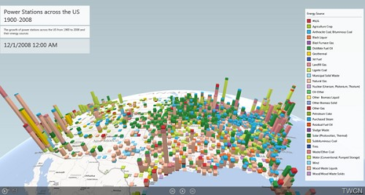
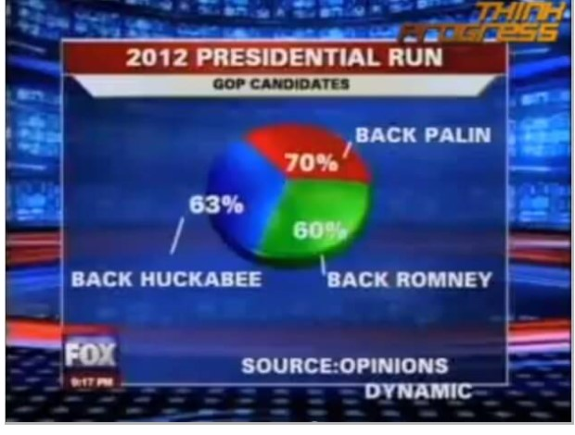
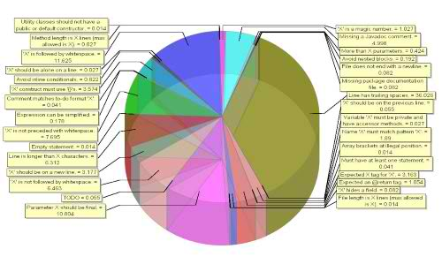
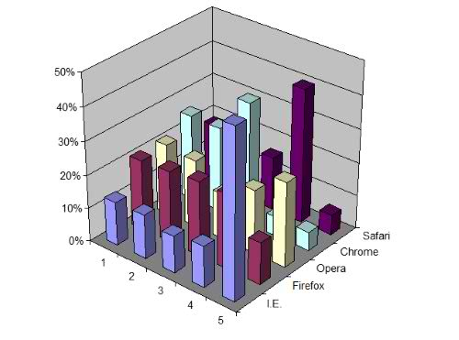

Slide 6

Let’s have a warm up
What’s a good
Data Visualization?

Slide 7
The Purpose
Data Visualization
is communication

Slide 8
Dataviz
communication
To drive action
To entertain
To persuade
To inform

Slide 9
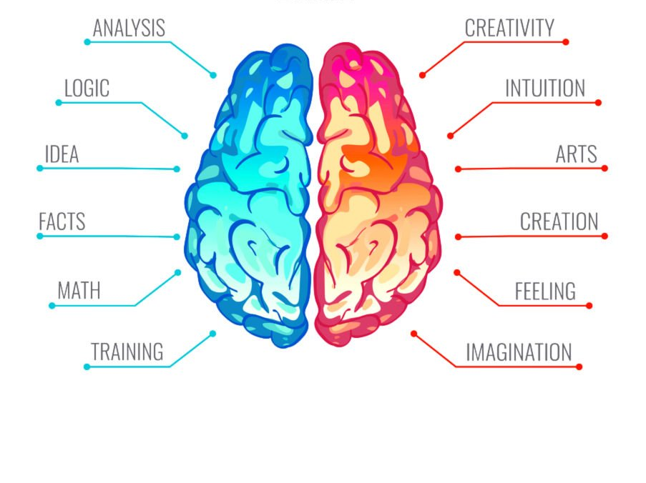

Dataviz
touches both side
Source : datascience.aero

Slide 10
Dataviz Questions
1. Which data is important to show?
2. What do I want to emphasize in the data?
3. What options do I have for displaying this data?
4. Which option is most effective in communicating the data?

Slide 11
Dataviz Questions
1. Which data is important to show?
2. What do I want to emphasize in the data?
3. What options do I have for displaying this data?
4. Which option is most effective in communicating the data?

Slide 12
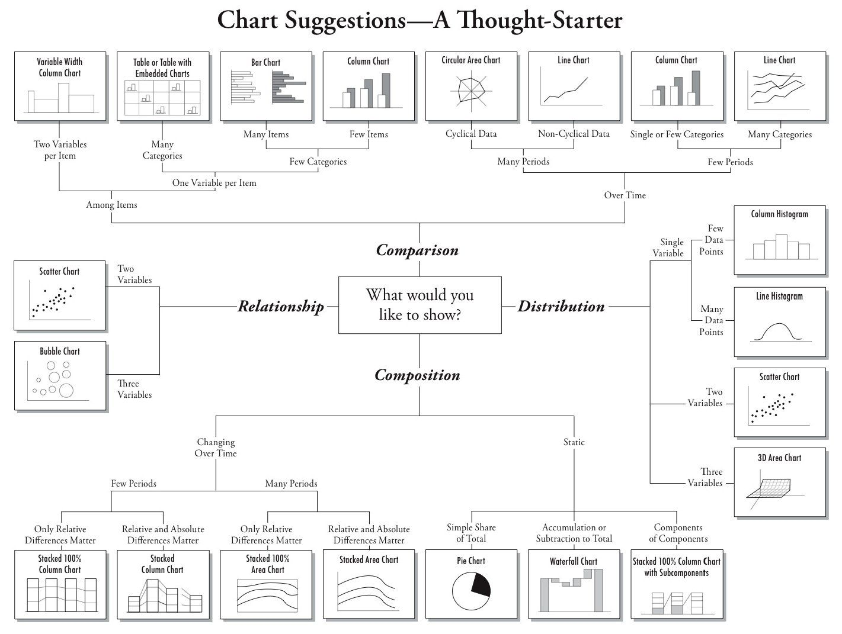
comparing and sorting data points
Chart Suggestions
relationship patterns between two or more variables
Comparison
comparison of data points along an axis
Relationship
Distribution
Composition
part-to-whole comparisons

Slide 13
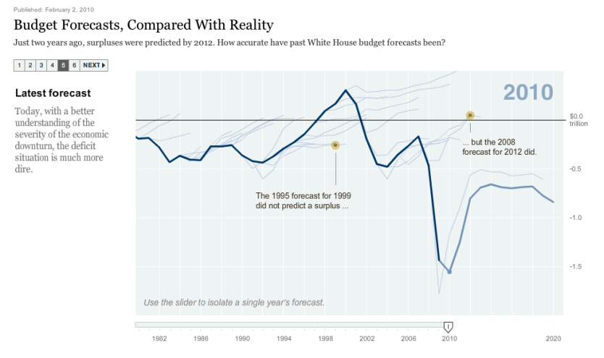
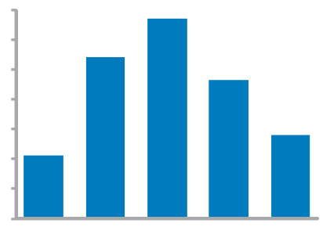
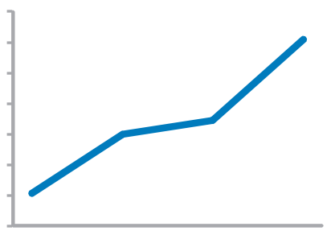
Time series values display how something changed over time
Bar Graph (vertical)
To feature individual values and support their comparisons.
Quantitative scale must begin at zero.
Line Graph
To feature overall trends and patterns and support their comparisons

Slide 14
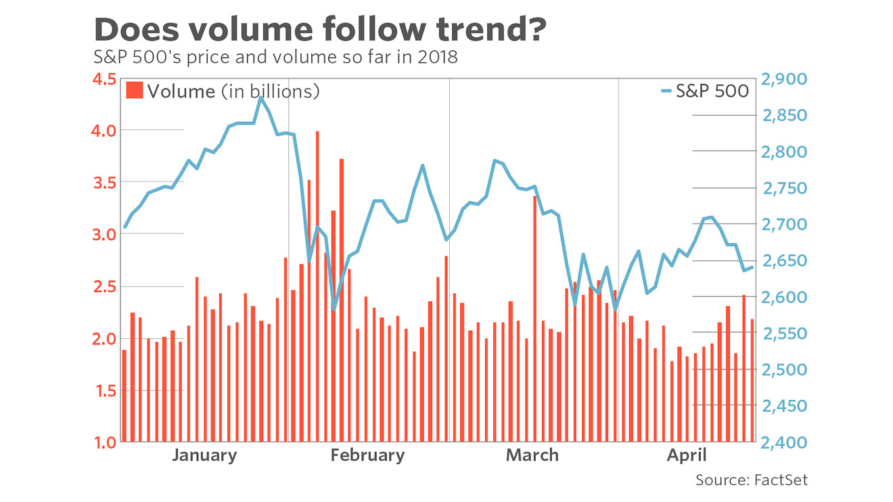
Time series values display how something changed over time

Slide 15
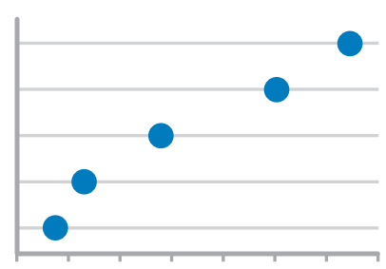
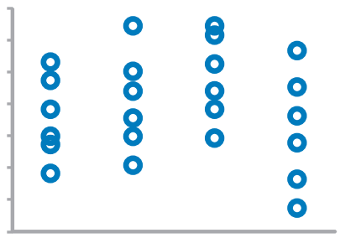
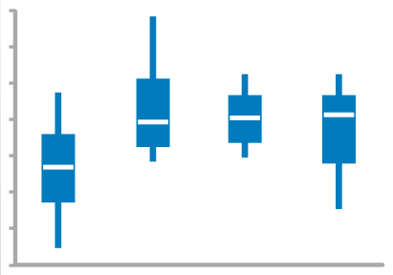
Time series values display how something changed over time
Dot Plot (vertical)
When you do not have a value for every interval of time
Strip Plot (multiple)
Only when also featuring distributions
Box Plot (vertical)

Slide 16
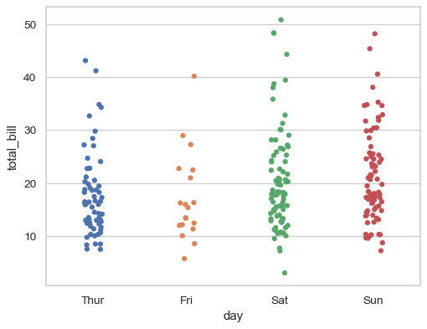
Time series values display how something changed over time

Slide 17
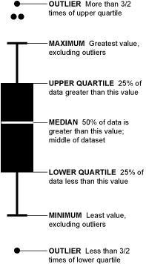
Time series BOX PLOT (VERTICAL)
Outliers
Highest
3rd Quartile
Median
1st Quartile
Lowest

Slide 18
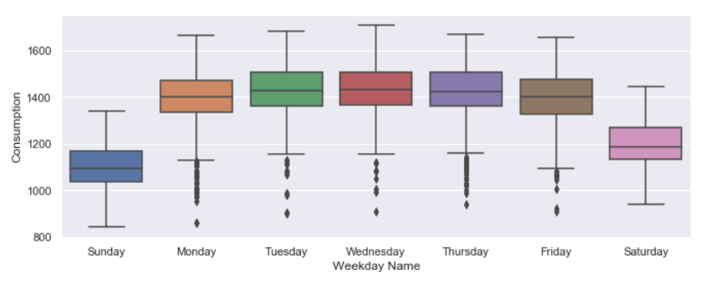
Time series Sample BOX PLOT (VERTICAL)
Electricity consumption per day
Notes:
https://www.dataquest.io/blog/tutorial-time-series-analysis-with-pandas/

Slide 19
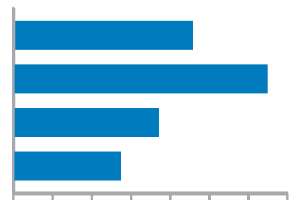
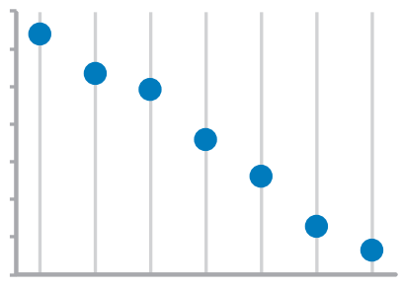
Ranking values are ordered by size (descending or ascending)
Bar Graphs
Quantitative scale must begin at zero
Dot Plots

Slide 20
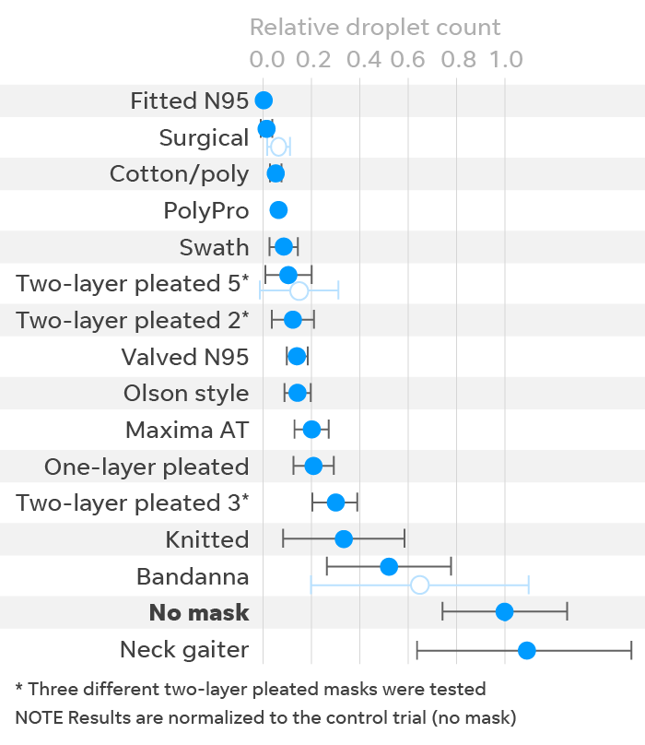
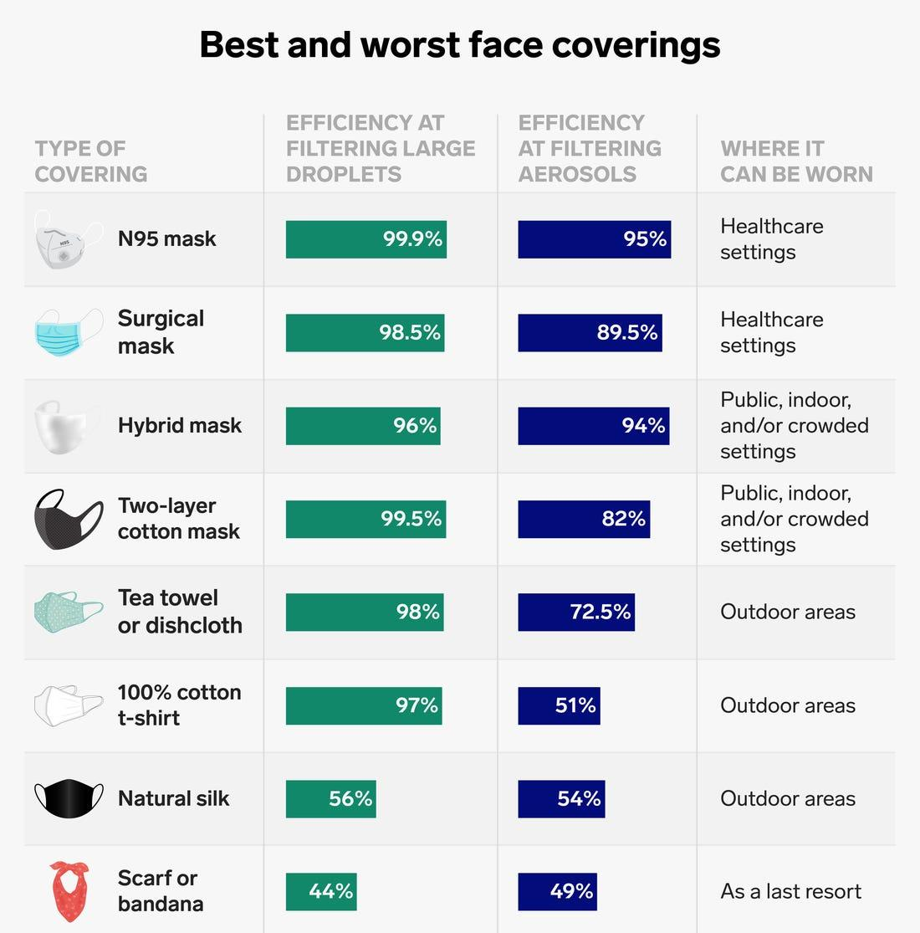
Ranking values are ordered by size (descending or ascending)

Slide 21
Part-to-whole values represent parts (ratios) of a whole
Bar Graphs
Quantitative scale must begin at zero

Slide 22
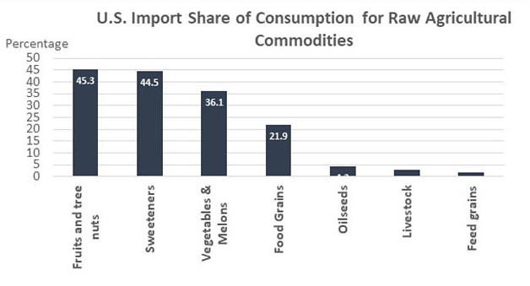
Part-to-whole values represent parts (ratios) of a whole

Slide 23
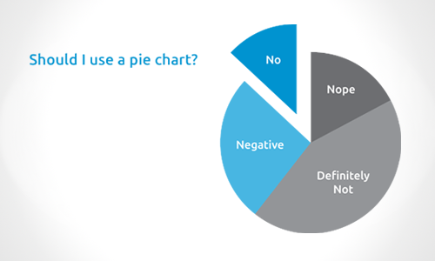
Part-to-whole values represent parts (ratios) of a whole

Slide 24
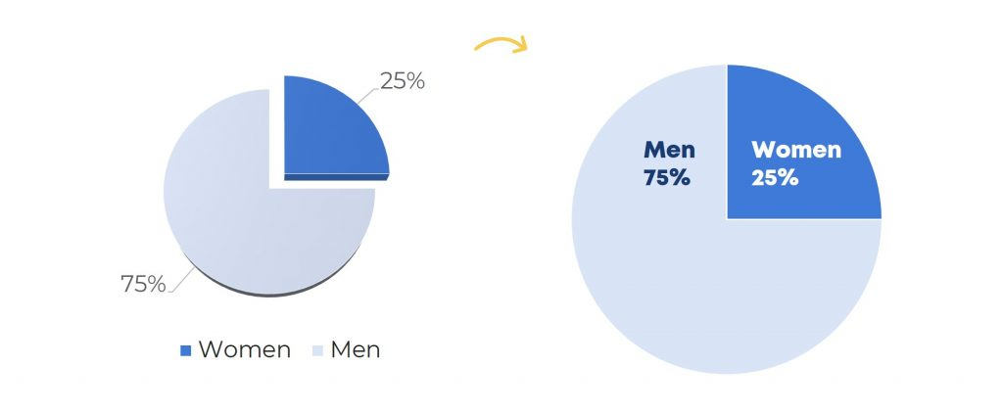
Part-to-whole values represent parts (ratios) of a whole
Use Pie Charts Only if...
1. You have Binary Data
2. You can format it

Slide 25
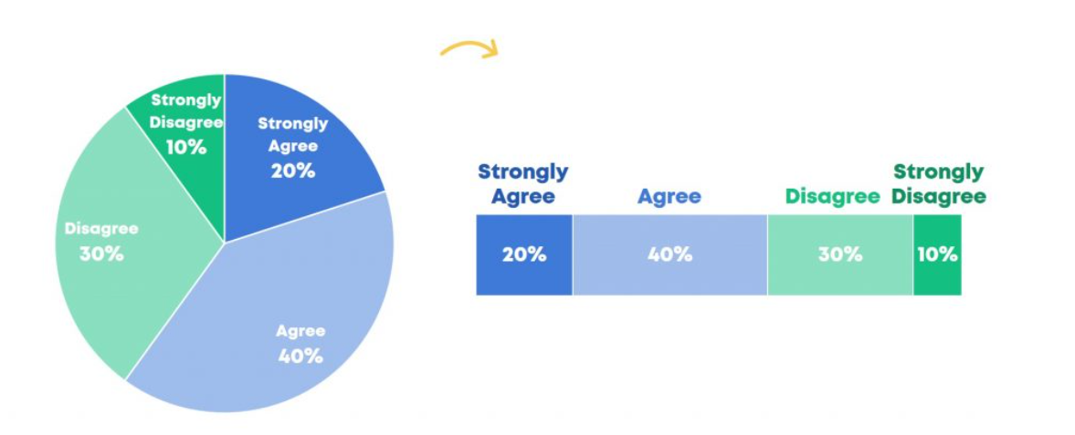
Part-to-whole values represent parts (ratios) of a whole
When not to use Pie Charts
1. You have Ordinal Data

Slide 26
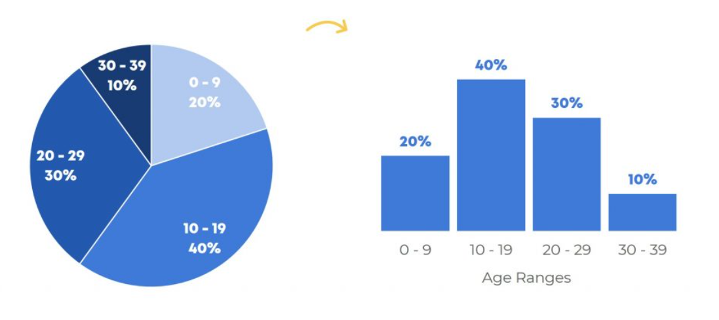
Part-to-whole values represent parts (ratios) of a whole
When not to use Pie Charts
1. You have Ordinal Data

Slide 27
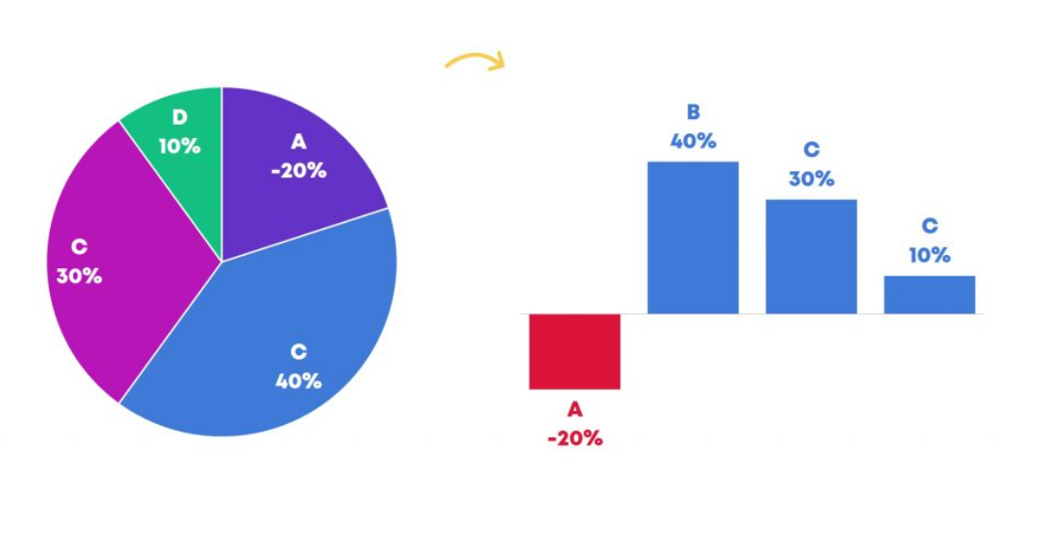
Part-to-whole values represent parts (ratios) of a whole
When not to use Pie Charts
2. You have a Negative Number

Slide 28
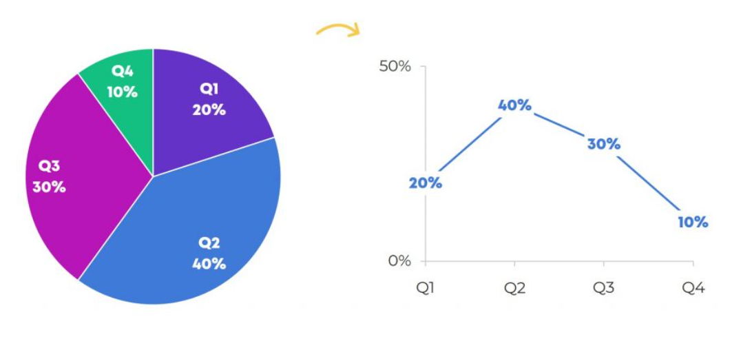
Part-to-whole values represent parts (ratios) of a whole
When not to use Pie Charts
3. You can form a Pattern

Slide 29
Deviation difference between two sets of values
Bar Graphs
Quantitative scale must being at zero
Line Graph
Only when also featuring time series or single distribution

Slide 30
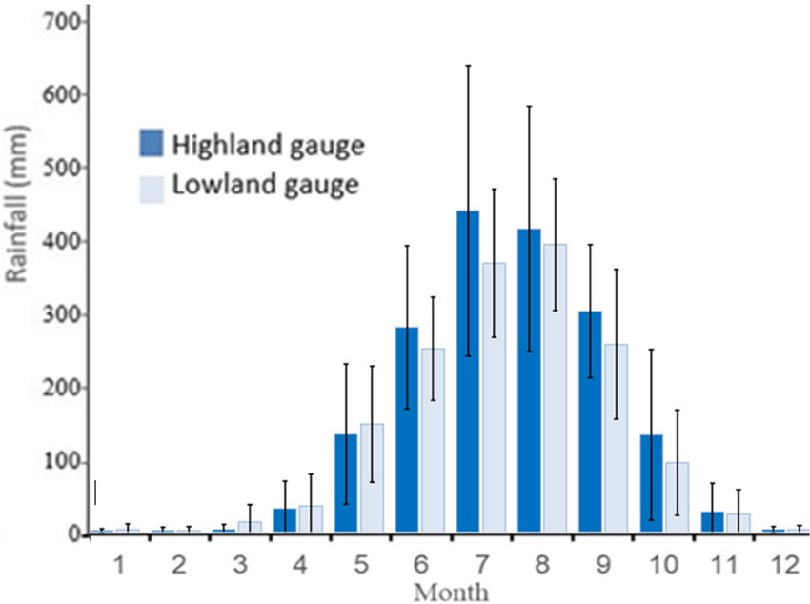
Deviation difference between two sets of values

Slide 31
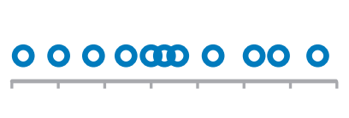
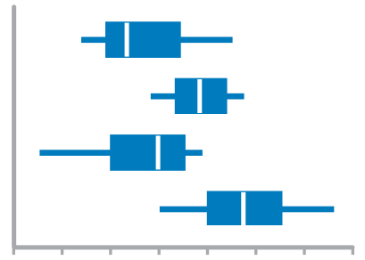
Distribution count of values per interval along quantitative scale
Strip Plot (single)
When you want to see each value
Bar Graphs
Quantitative Scale, must begin at zero
Strip Plot (multiple)
When comparing multiple distributions AND you want to see each value
Line Graph
To feature overall shape of distribution
Box Plots
When Comparing Multiple Distributions

Slide 32
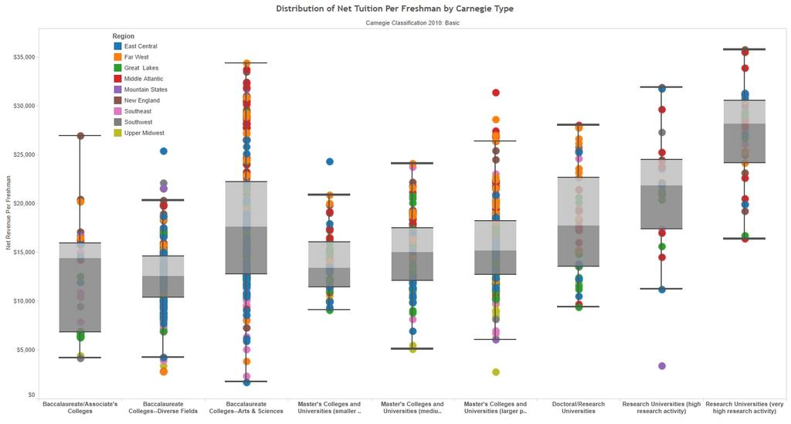
Distribution count of values per interval along quantitative scale

Slide 33
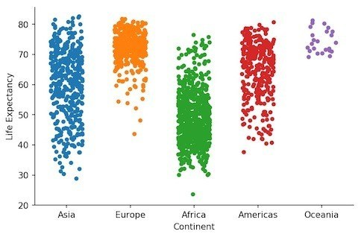
Distribution count of values per interval along quantitative scale

Slide 34
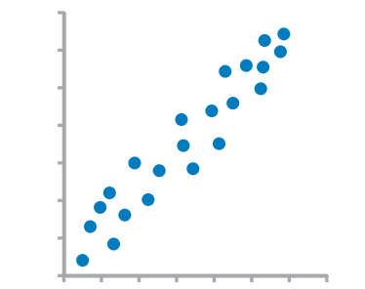
Correlation Comparison of two paired sets of values to determine if there is a relationship between them
Scatter Plot

Slide 35
Normal comparison simple comparison of values for a set of ordered items
Bar Graphs
Quantitative scale must begin at zero
Dot Plots

Slide 36
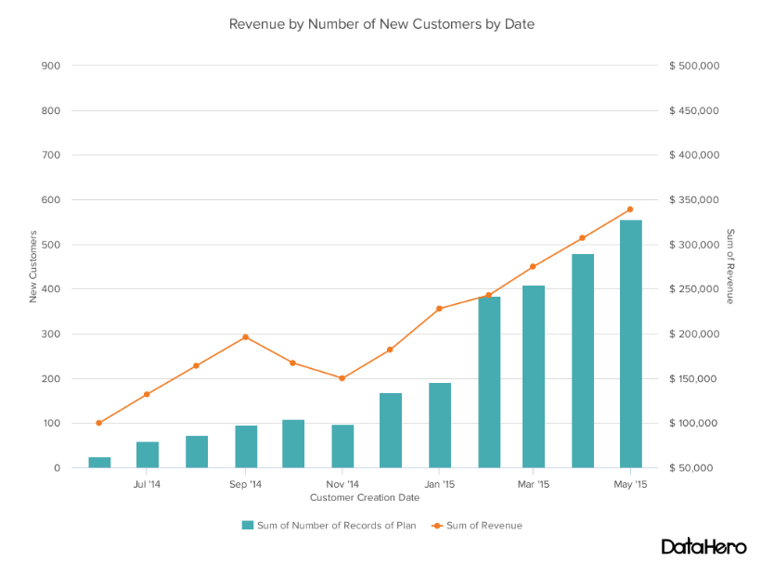
VISUAL BEST PRACTICES
Examples
Notes:
https://visme.co/blog/dos-and-donts-chart-making/

Slide 37
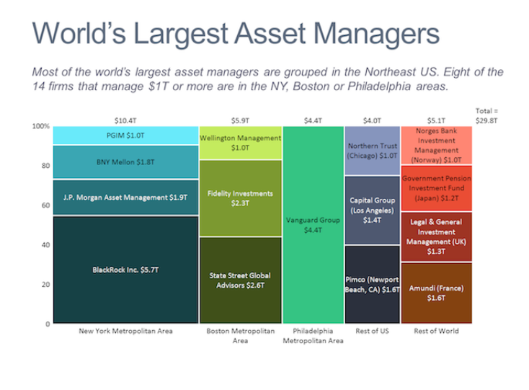
VISUAL BEST PRACTICES
Examples
Notes:
https://visme.co/blog/dos-and-donts-chart-making/

Slide 38
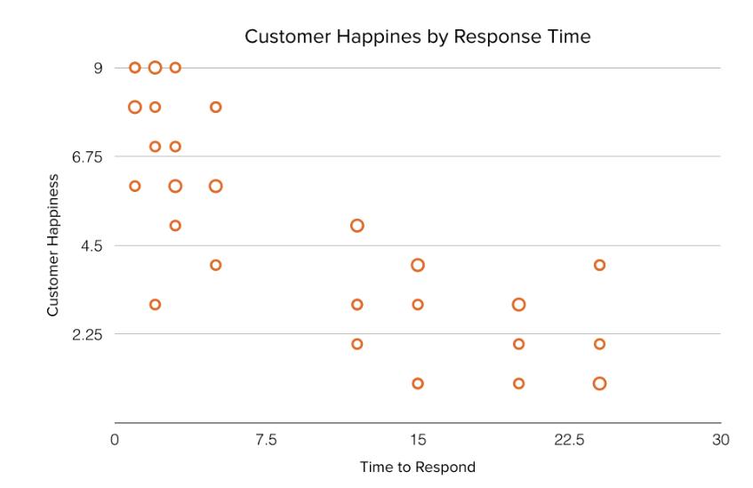
VISUAL BEST PRACTICES
Examples
Notes:
https://visme.co/blog/dos-and-donts-chart-making/

Slide 39
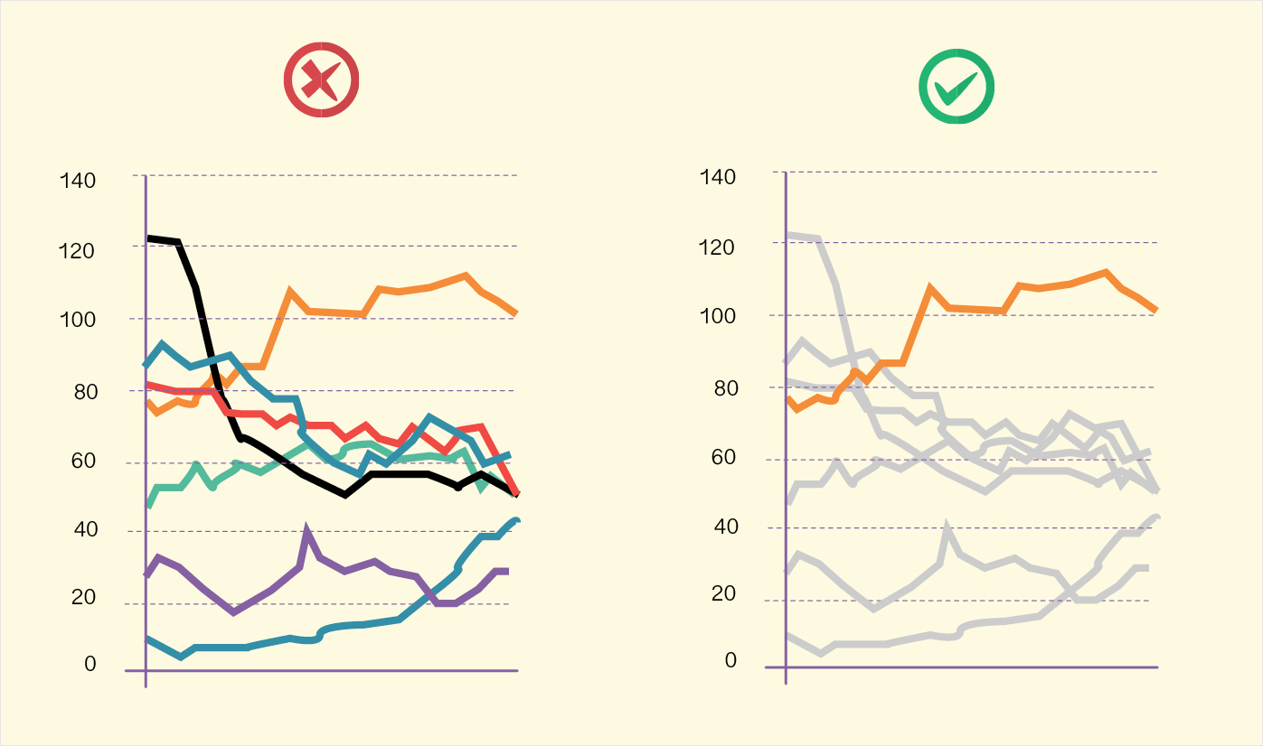
VISUAL BEST PRACTICES
Best Practices
Emphasize
most important data
Orient
graphs for legibility
Organize
graph/table
Avoid
overloading graphs
Limit
# of colors and shapes
Inform
through important text
Notes:
https://visme.co/blog/dos-and-donts-chart-making/

Slide 40
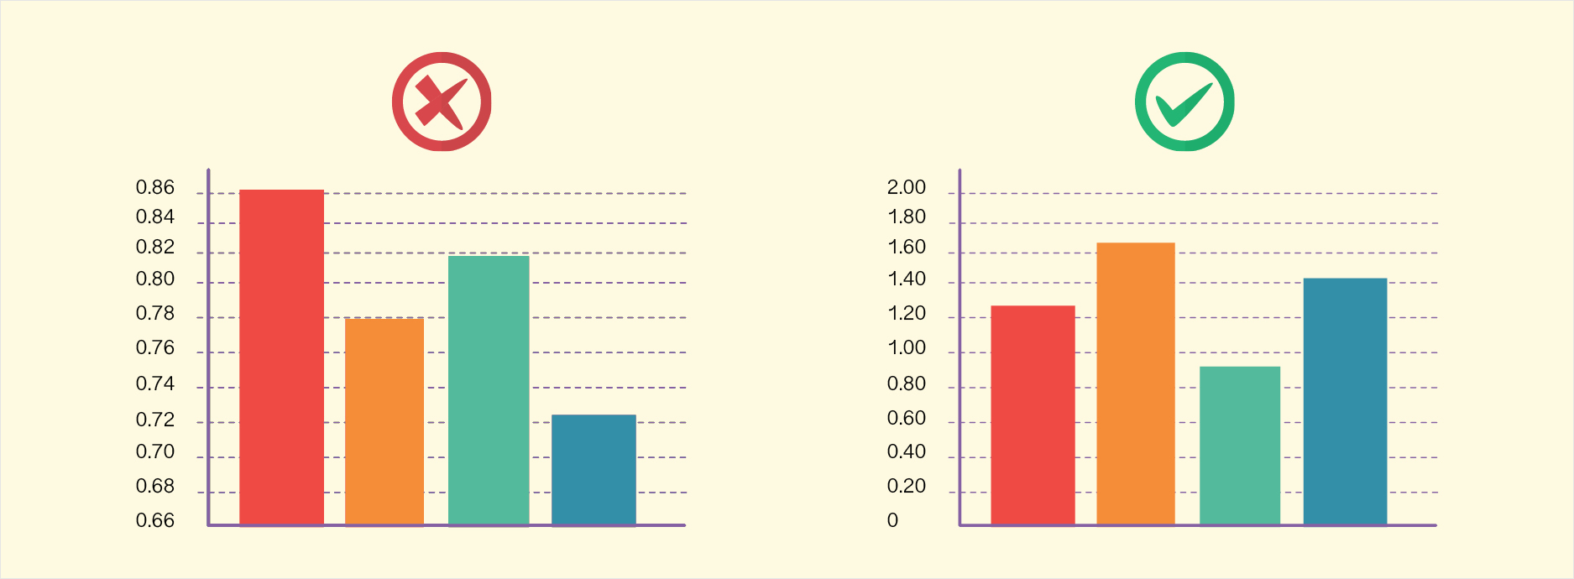
VISUAL BEST PRACTICES
Best Practices
Emphasize
most important data
Orient
graphs for legibility
Organize
graph/table
Avoid
overloading graphs
Limit
# of colors and shapes
Inform
through important text

Slide 41
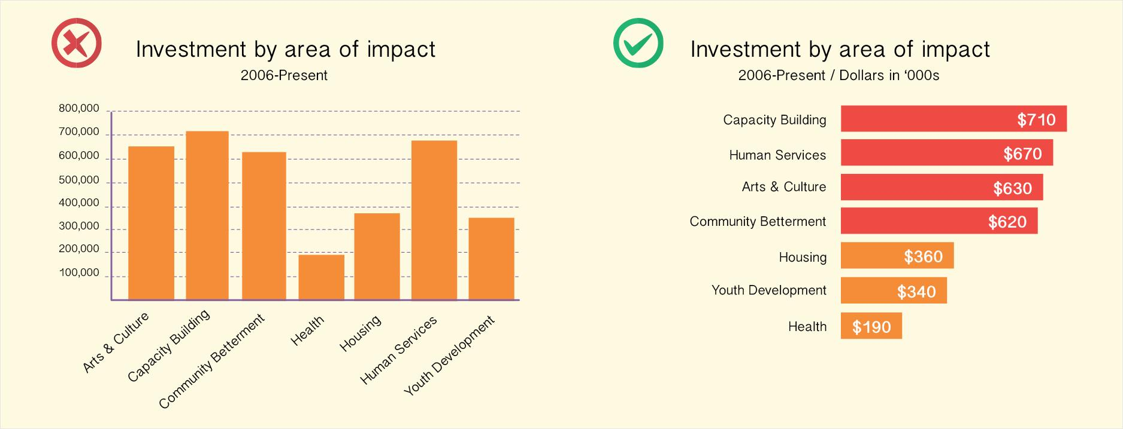
VISUAL BEST PRACTICES
Best Practices
Emphasize
most important data
Orient
graphs for legibility
Organize
graph/table
Avoid
overloading graphs
Limit
# of colors and shapes
Inform
through important text

Slide 42
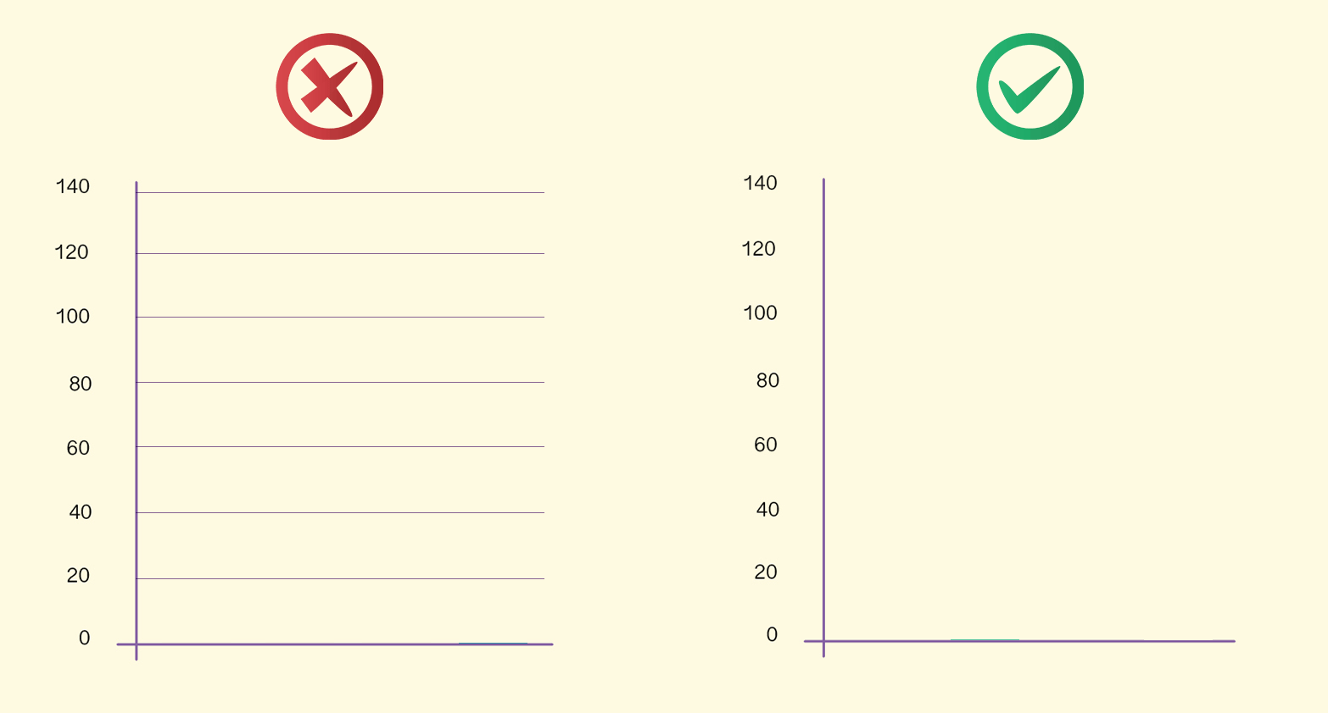
VISUAL BEST PRACTICES
Best Practices
Emphasize
most important data
Orient
graphs for legibility
Organize
graph/table
Avoid
overloading graphs
Limit
# of colors and shapes
Inform
through important text

Slide 43
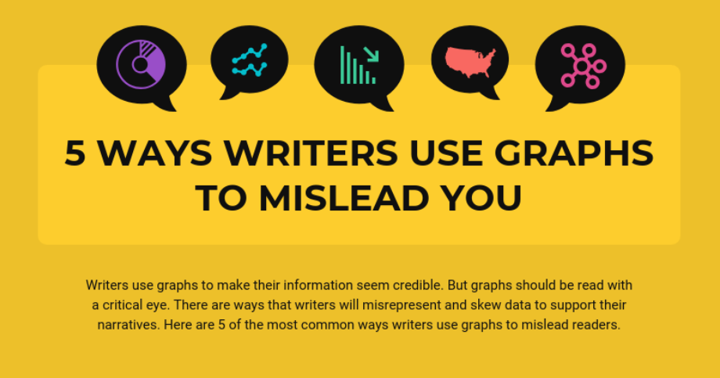


Slide 44
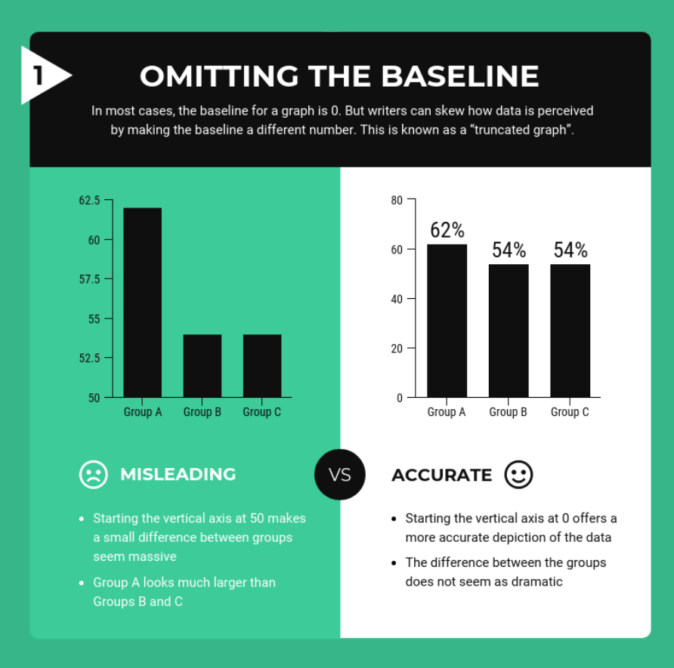

Slide 45
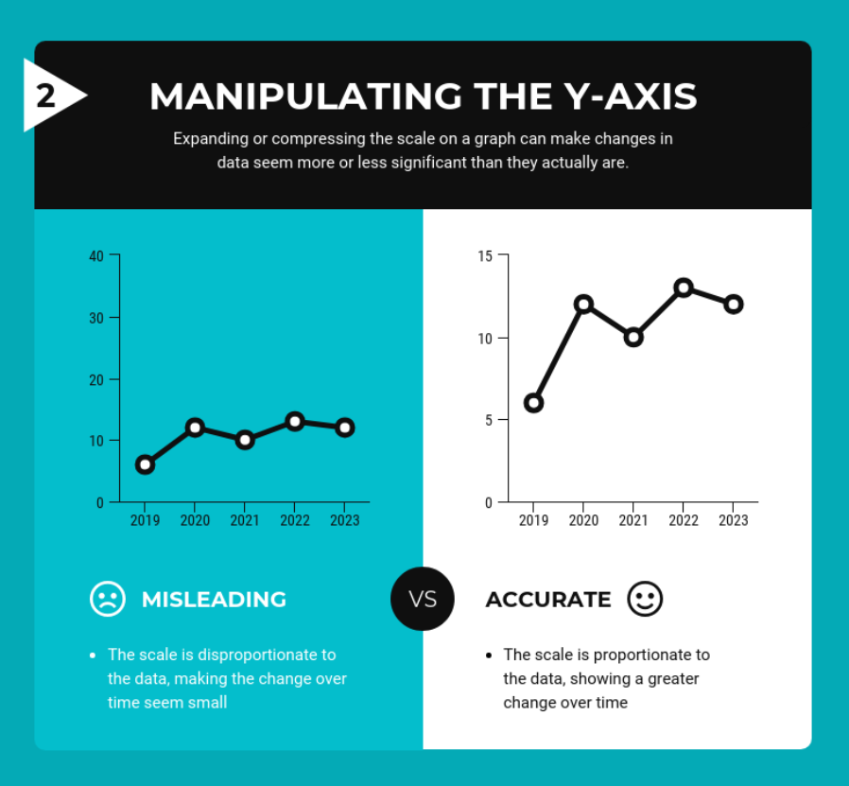

Slide 46
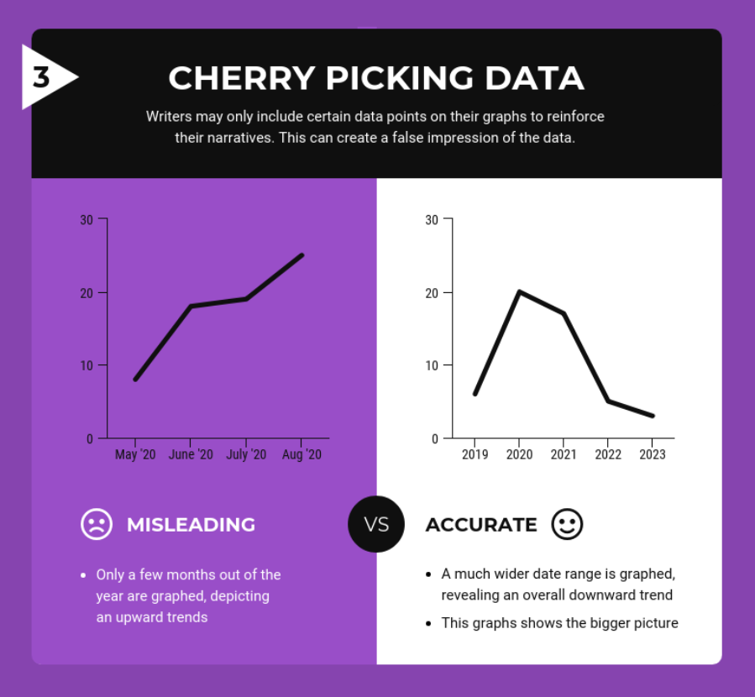

Slide 47
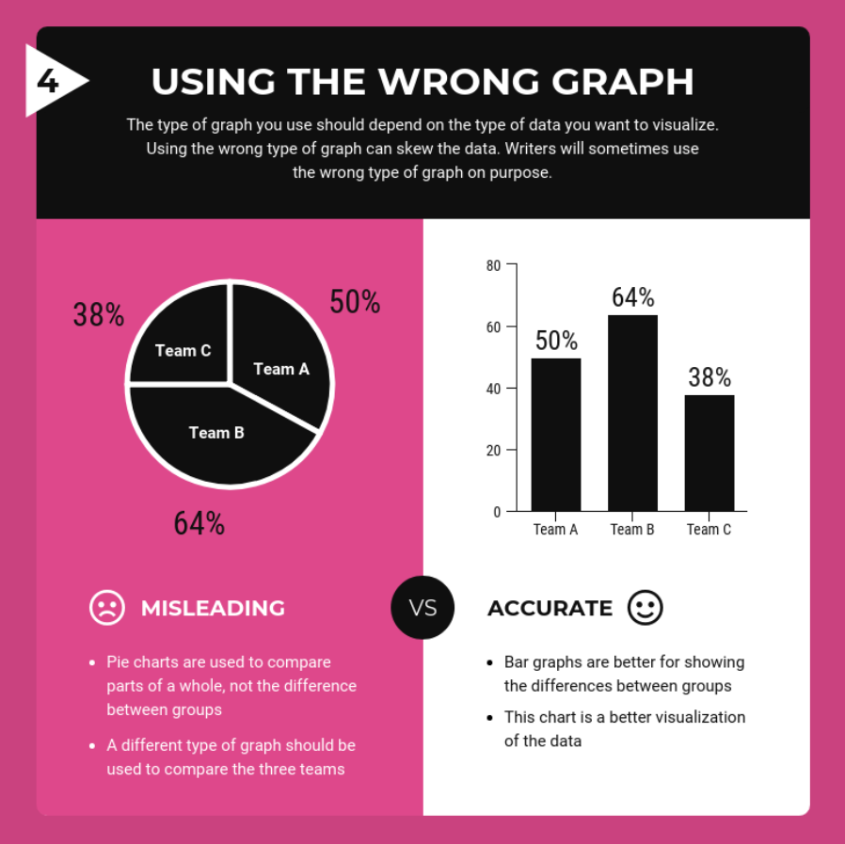

Slide 48
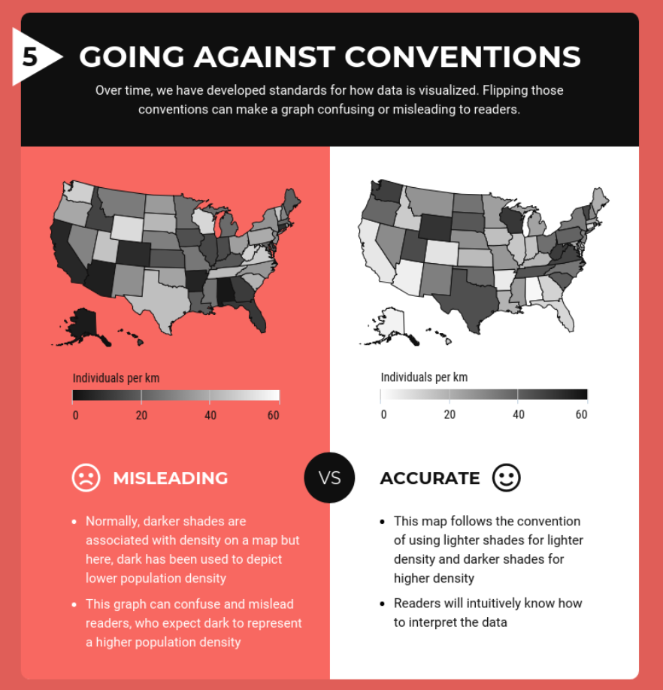

Slide 49
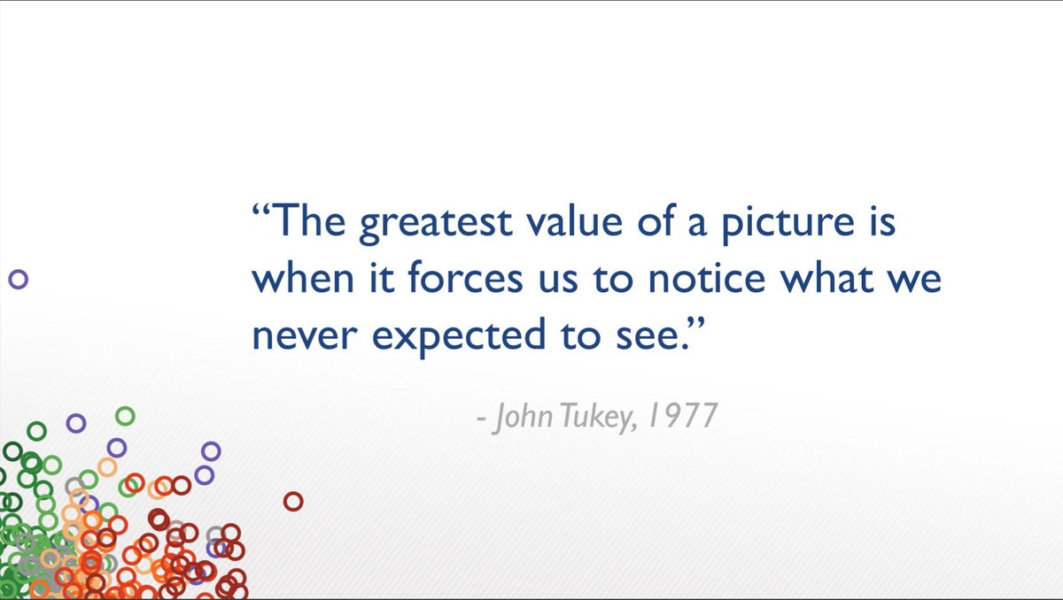
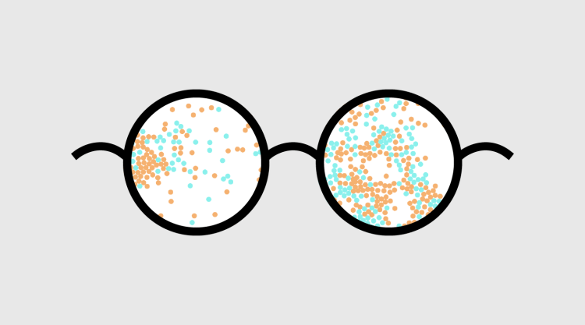

Slide 50

Questions?

